Slide 1




Population Estimates and Hypothesis Tests

Slide 2

Agenda
Overview of statistics that we will cover & extra credit pts
CE7
Confidence interval lecture

Slide 3
Discussion Case #8
Homecare of America (confidence intervals)
DO both Part A and Part B. Be prepared to show your work on the whiteboard in class and to explain what the answers mean.
A .
Homecare Of America is a franchise operation which provides house minders for people when they are out of town. Their services include feeding pets, bringing in newspapers and mail, and generally keeping an eye on things while the homeowner is gone. They are gradually expanding their operations to additional cities.
When determining whether to enter a particular market, the company conducts a survey in that market to find out how many days per year homeowners are out Of town. In Scranton, Pennsylvania, a survey of 538 homeowners found that homeowners are out Of town, on average, 16.7 days, with a standard deviation Of 8.6 days. What is the true mean number of days out of town among ALI homeowners in this area? You want to be 99% confident of your results.
B .
In their surveys, the company also describes their house minding services and measures respondents' intentions to use this service if the company expanded to their area. In the survey of Scranton, 6.2% of the people surveyed said they would be likely to use the service. What is the likely utilization rate for this service among the population Of homeowners in Scranton? You want to be 95% confident of your results. Carry your work Out to 4 decimal places.

Slide 4
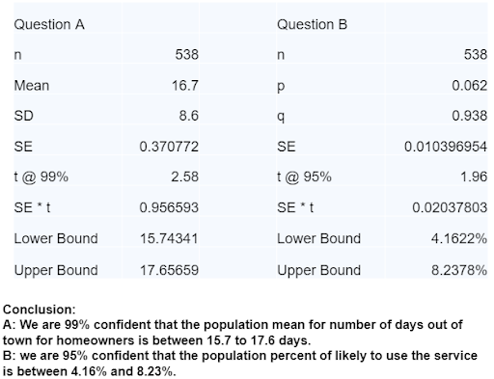

Slide 5
CE7 Questions
What’s the use of confidence interval for the manager?
What is the difference between using 95% confidence versus 99% confidence? Does 95% confidence mean 95% people fall in the confidence interval?
Would the data from A be interpreted as homeowners are out of town for 15.7 days to 17.7 days?
Do you think that from B if they changed the percent of people who surveyed to a higher number do you believe the data would increase?
Will the formula be provided in exam? Do I need to round the decimals?
What’s difference between Z vs. T value?

Slide 6


Inference – Statistics and Parameters
What do statistics measure?
What do parameters measure?

Slide 7
Statistics vs. Parameters
Statistics: values that are computed from information provided by a sample (e.g., sample average)
Parameters: values that are computed from a complete census which are considered to be precise and valid measures of the population (e.g., population average)
In other words, Parameters represent “what we wish to know” about a population. Statistics are used to estimate population parameters
Generalizing a Sample’s Findings to Its Population
Population
Sample
Notes:
Note: we cannot use sample statistics (sample mean from a sample of Mizzou students) directly, since we are interested in the population parameters (population mean from all the Mizzou students). We need to do the calculations in today’s lecture to infer the population parameters by factoring in the uncertainty in our sample statistics.

Slide 8
Statistical Inference
A set of procedures in which the sample size and sample statistics (e.g., sample average and sample standard deviation) are used to make estimates of population parameters

Slide 9
Parameter Estimation
What we know: sample statistics such as mean, mode, standard deviation, range etc.
The sample statistic may be either a percentage, (i.e., 12% of the respondents stated they were “every likely” to patronize a new restaurant OR the sample statistics may be a mean, i.e., the average amount spent per month in restaurants is $185
Use sample statistics to infer about the population through confidence intervals
So what is confidence intervals?

Slide 10
Parameter Estimation
Confidence level: most commonly used level of confidence: 95%; corresponding to 1.96 for the t value. Or 99% t = 2.58
Confidence Interval:
For mean (xbar – t_critical * SE , xabar + t_critical* SE)
Standard error = SD/ \sqrt(n)
For percentage, (p – t _critical * SE , p + t_critical* SE), where p = 1-q
Standard Error = \sqrt[(p * q )/n]
Notes:
Note: 95% confidence in math means we draw 100 samples, 95% of the sample average will fall within the range.

Slide 11
iClicker
Those who dine out on Wednesday’s, spend on an average $45.2, SD = 20, n = 500, 95% confidence (t = 1.96)
Notes:
Formula:
For percentage, p + t*SE, p – t*SE
For mean, xbar + t*SE, xbar – t*SE
p is the sample percent. xbar is the sample mean.
SE: standard error
For percentage: square root (p*q/n) note: p = 1-q
For mean:SD/square root(n) note: SD is standard deviation
t value @ difference confidence level: @90%: 1.65 @95%: 1.96 @99%: 2.58
Question: a) why do we need confidence interval? why can’t we just use the descriptive statistics - mean or percent?

Slide 12
Answers
Compute Confidence Intervals
Mean = 45.2, SD = 20, n = 500
[45.2 +/- 1.96*20/SQRT(500)]
$43.45 - $46.95
We are 95% confident that in population the people who dine out on Wednesday spend between $43.45 to $46.95

Slide 13
iClicker
30% people say they dine out on Wednesday’s, n =500, 95% confidence (i.e., t = 1.96)
Notes:
Formula:
For percentage, p + t*SE, p – t*SE
For mean, xbar + t*SE, xbar – t*SE
p is the sample percent. xbar is the sample mean.
SE: standard error
For percentage: square root (p*q/n) note: p = 1-q
For mean:SD/square root(n) note: SD is standard deviation
t value @ difference confidence level: @90%: 1.65 @95%: 1.96 @99%: 2.58
Question: a) why do we need confidence interval? why can’t we just use the descriptive statistics - mean or percent?

Slide 14
Answer
Compute Confidence Intervals
p = 30%,n =1,000, t=1.96
26.0% -34.0%
[30-1.96*SQRT(30*70/500), 30+1.96*SQRT(30*70/500)]
We are 95% confident that in population, 26% to 34% of people dine out on Wednesday.

Slide 15
Parameter Estimation
What does confidence level mean?
It means that we can say that if we did our study over 100 times (although we only did ONCE), we can determine a range within which the sample statistic will fall 95 times out of 100 (95% level of confidence). This gives us confidence that the real population value falls within this range
100 times, ($32, $35) $33.5

Slide 16
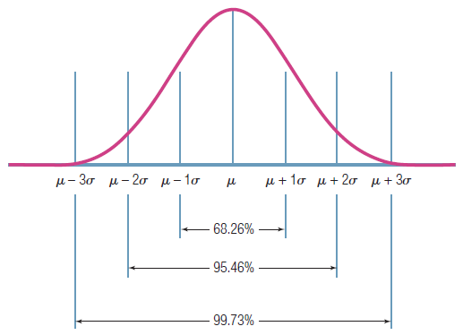
Confidence level visualization – increase the confidence level, the interval will be widened
95% confidence level covers the 95% of sample mean if we keep drawing the samples from the population randomly
Notes:
Sigma here stands for the population average standard deviation – it is calculated by the sample SE = SD/SQRT(n)
mu is the population average. sigma is the population variation.

Slide 17
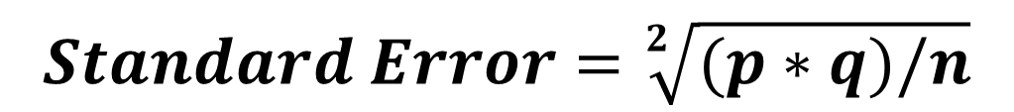

Parameter Estimation
If we have percentage,
If we have mean,
Given the same sample size, the more variability, the __ the standard error.
The lower the standard error, the __ precisely our sample statistic will represent the population parameter
Notes:
Note the SD (standard deviation) and SE (standard error) are different in formula.

Slide 18
Recap
Five steps involved in computing confidence intervals for a mean or percentage:
Determine the sample statistic (e.g., percentage, sample average)
Identify the sample size, n & Determine the variability in the sample for that statistic/Compute the mean
Decide on the desired level of confidence -t value
Perform the computations to determine the upper and lower boundaries of the confidence interval range (typically at 95%). Make sure to interpret it for the manager!

Slide 19
CE7
What’s the use of confidence interval for the manager?
What is the difference between using 95% confidence versus 99% confidence? Does 95% confidence mean 95% people fall in the confidence interval?
Would the data from A be interpreted as homeowners are out of town for 15.7 days to 17.7 days?
Do you think that from B if they changed the percent of people who surveyed to a higher number do you believe the data would increase?
Will the formula be provided in exam? Do I need to round the decimals?
What’s difference between Z vs. T value?

